Slide 1
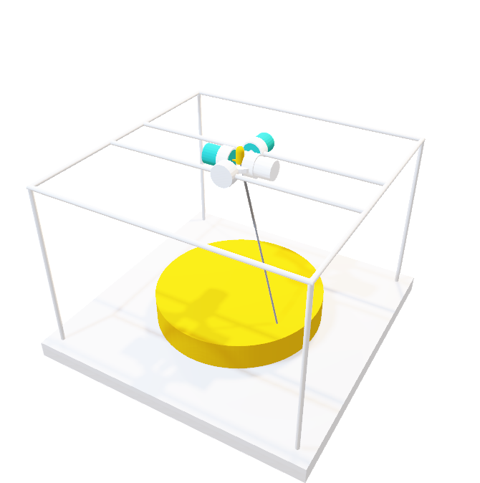
Selective Laser Sintering 3D Printer
ELEC 341 Design Project
Part 1
Muchen He 44638154
Ou Liu 18800152

Slide 2
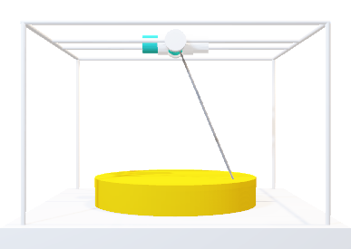
System Overview
Coordinates (X, Y, Z)
The 3D printer uses a laser to build parts. The laser is oriented using a two-axis motor assembly.
Inverse Kinematic
The inverse kinematic module converts the Cartesian coordinates to the desired motor angle.
The joint controller module handles the system response and controller.
Controller
The direct kinematic converts actual motor angles back to Cartesian coordinates
Direct Kinematic
The laser control module adjusts the intensity of the laser based on how far the target is
The motors control the orientation of the laser
Laser Control
Motors
Sensor & Feedback

Slide 3
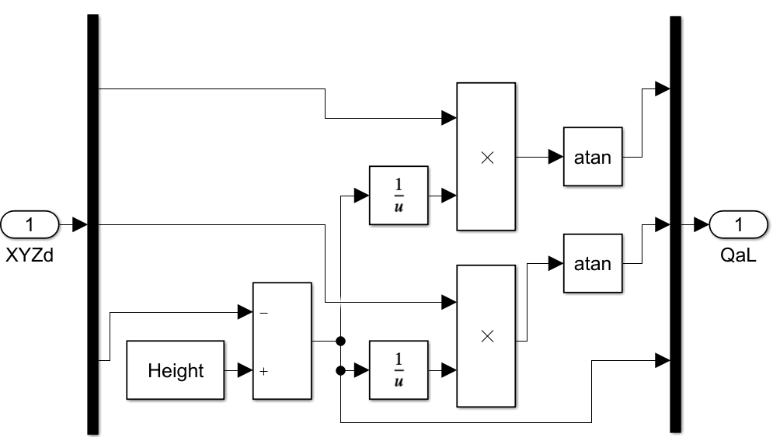
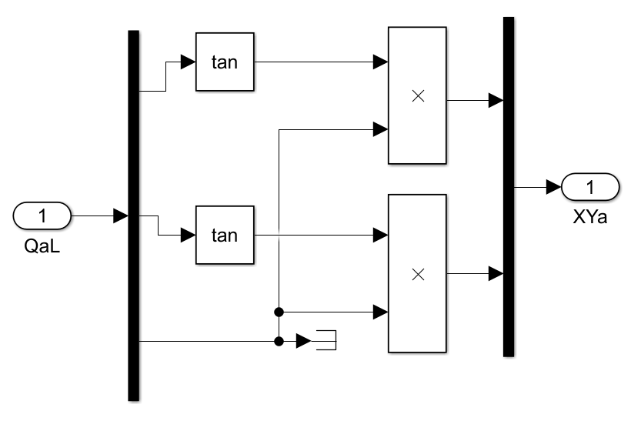
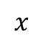


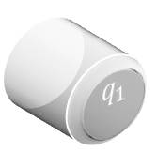



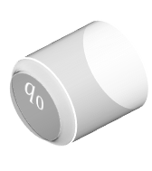

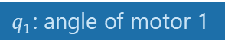

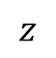

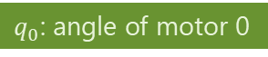
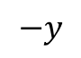
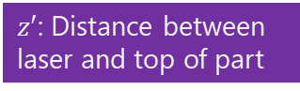
$$z$$
Inverse & Direct Kinematic
$$q_{1}$$
$$q_{0}$$
The inverse kinematic module converts the Cartesian coordinates to the desired motor angle.
$q_{0}$: angle of motor 0
$$q_{0}=\tan^{−1}{\frac{x}{z^{′}}}$$
$$q_{1}=\tan^{−1}{\frac{y}{z^{′}}}$$
$$z^{′}=\text{he}\text{ight}−z$$
$q_{1}$: angle of motor 1
$z′$: Distance between laser and top of part
Desired $x$
The direct kinematic converts actual motor angles back to Cartesian coordinates
Desired $y$
$$x=z′\tan\left(q_{0}\right)$$
Desired $z$
$$−y$$
$$y=z′\tan\left(q_{1}\right)$$
$$x$$
I.K. implementation in SimuLink
D.K. implementation in SimuLink

Slide 4
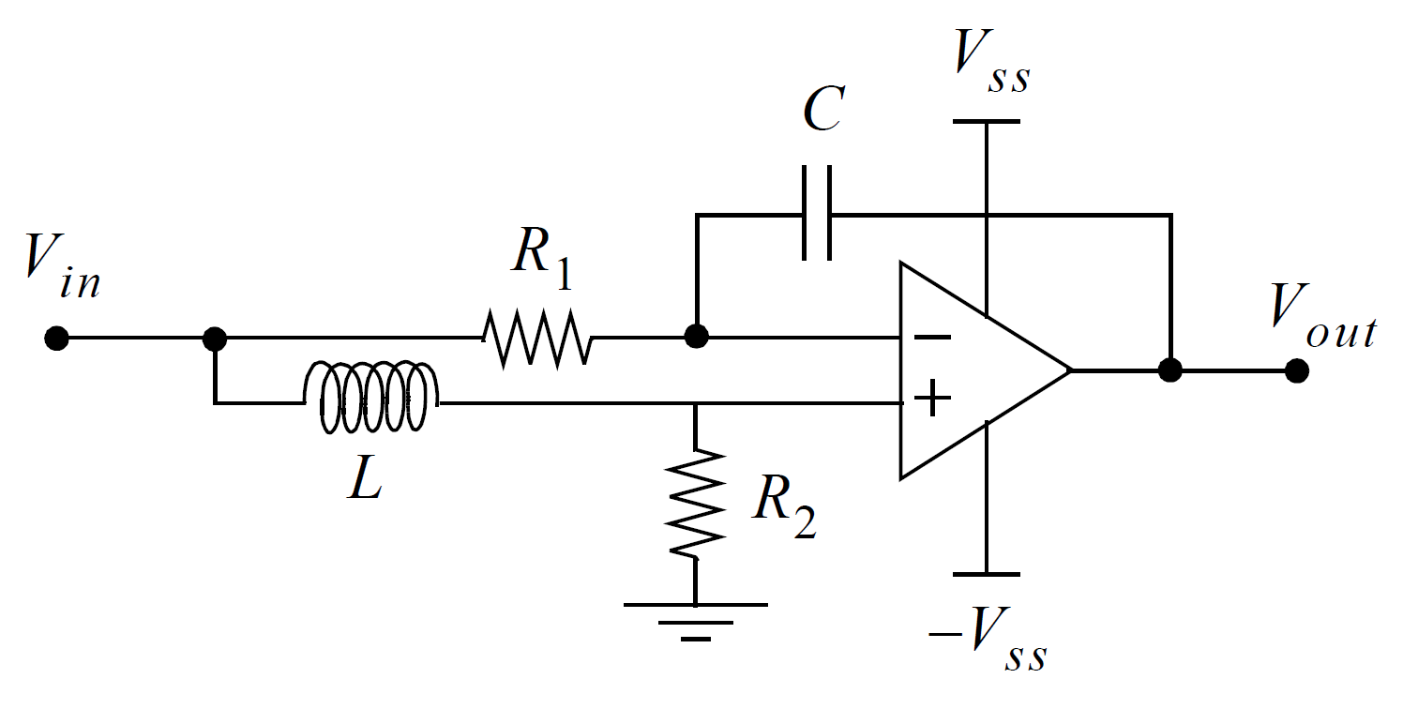
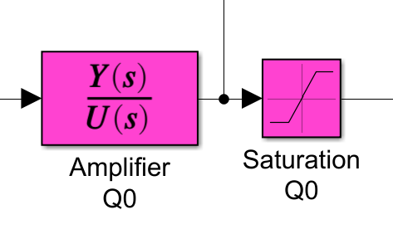
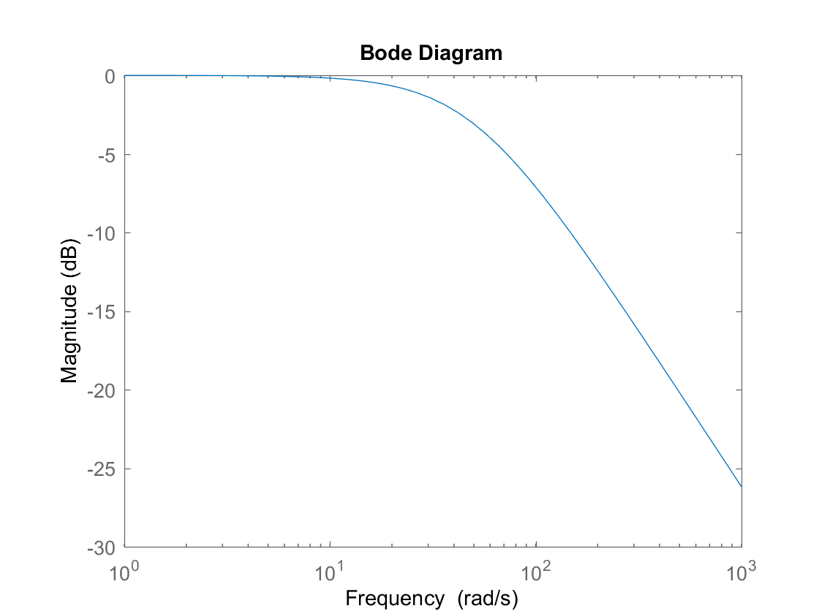
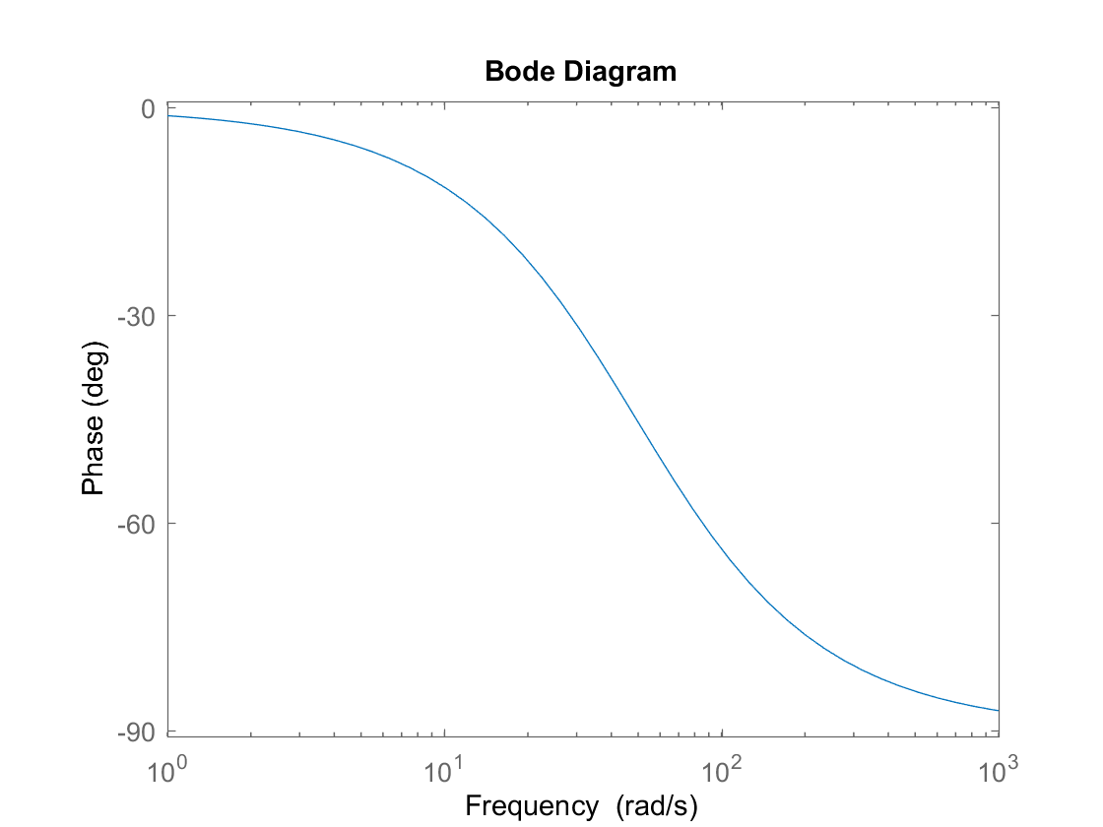





Power Amplifier
$$V_{n}$$
The power amplifier takes the role of a filter and a voltage follower.
The transfer function is the output divided by input.
Since there is negative feedback coupled by the capacitor, $V_{n}=V_{p}$.
MNA is used to solve the circuit
$$V_{p}$$
Amplifier circuit
SimuLink implementation
MNA:
$$\frac{V_{in}−V_{n}}{Ls}=\frac{V_{n}}{R_{2}}$$
$$\frac{V_{in}−V_{n}}{R_{1}}=\left(V_{n}−V_{out}\right)×sC$$
Transfer Function: $\frac{Y(s)}{U(s)}=\frac{V_{out}}{V_{in}}$ $=\frac{CR_{2}R_{1}−L}{LCR_{1}s+CR_{1}R_{2}}$

Slide 5

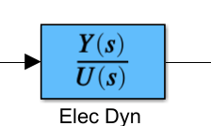
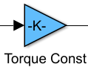
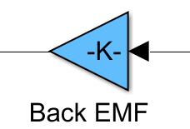

















Electric Motor Dynamics
Response
Implementation
Torque Gain
Back EMF Gain
The DC motor has relationships between the torque and the current
$$I$$
$$τ$$
$$V$$
$$ω$$
$$τ=K_{τ}i$$
$$V_{i}$$
$$V_{o}$$
The current is given by Ohm’s law
$$i=\frac{V_{in}−V_{emf}}{Ls+R}$$
The back-EMF is proportional to the motor speed
$$V_{emf}=K_{b}ω$$
The two motors for $q_{0} and q_{1}$ are identical, so the relationships are the same for both motors
Motor 0
$$L$$
$$R$$
$$V_{in}$$
$$V_{emf}$$
Equivalent circuit
Motor 1
$$\frac{Y(s)}{U(s)}=\frac{1}{Ls+R}$$

Slide 6
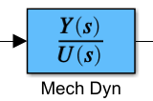

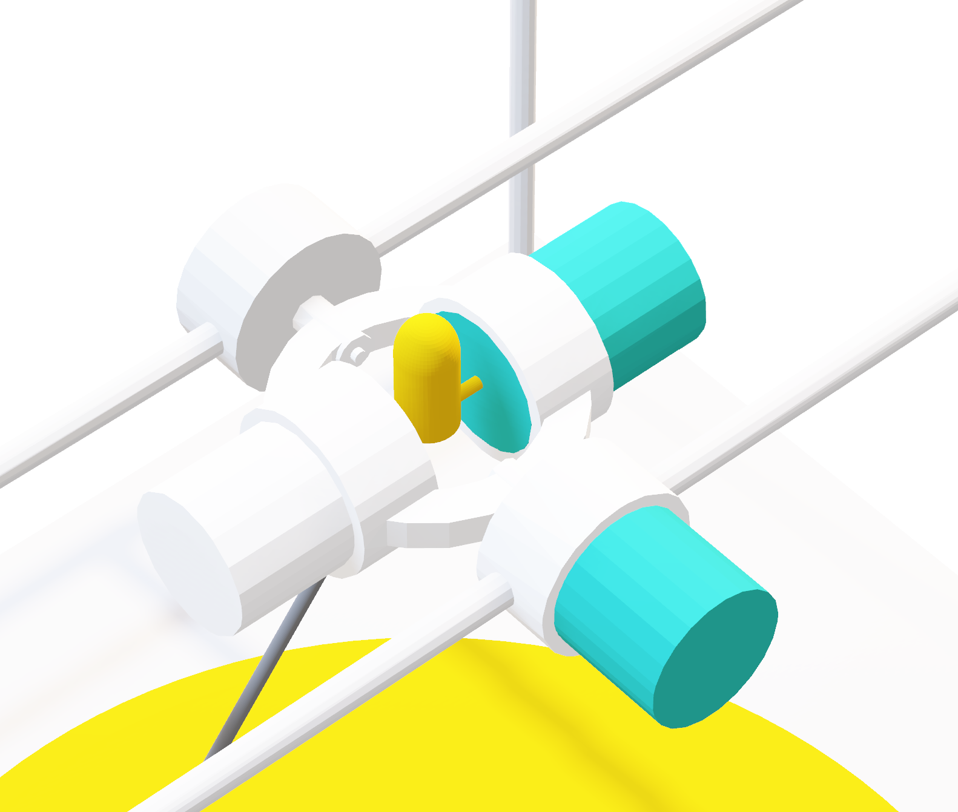








Mechanical Motor Dynamics
Mechanical motor dynamics is a transfer function that converts torque to angular speed. It is given as:
$$\frac{Y(s)}{U(s)}=\frac{ω}{τ}=\frac{s}{Js^{2}+Bs+K}$$
Where $J$ is moment of inertia, $B$ is the kinetic friction constant, and $K$ is the spring constant.
Kinetic friction is the due to the mass imposed on the motion given as
$$B=\frac{I_{\text{noLoad}} K_{τ}}{ω_{\text{noLoad}}}$$
Spring constant is 0 for motor 1 and positive for motor 0
Implementation
Moment of inertia for motor 1 is $J_{\text{rotor}}$ since the laser has negligible mass
$$τ$$
$$ω$$
$J_{q1}=$ $J_{\text{rotor}}$

Slide 7
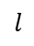

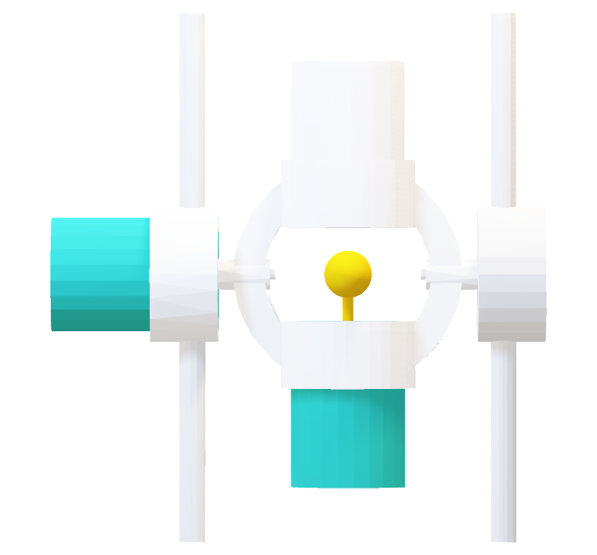
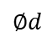
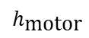

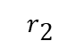
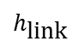
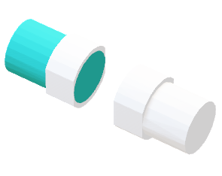
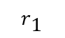
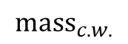

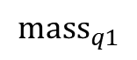
Mechanical Motor Dynamics
$${\text{mas}\text{s}}_{c.w.}$$
The moment of inertia component for motor 1 is the superposition of four parts
$$h_{\text{motor}}$$
$$r_{\text{2}}$$
$$l$$
Motor 0 rotor: Inertia due to the internal rotor of the outer motor
$$r_{\text{1}}$$
Aluminium link: Hollow cylinder. Mass is its volume multiplied by 6061 aluminium density
$$J_{\text{link}}=\frac{{\text{m}\text{ass}}_{\text{link}}}{12}\left(3\left({r_{2}}^{2}+{r_{1}}^{2}\right)+{h_{\text{l}\text{ink}}}^{2}\right)$$
$${\text{mas}\text{s}}_{q1}$$
Motor 1 & counter weight: $\text{mas}{\text{s}}_{c.w.}=\text{mas}{\text{s}}_{q1}$
Motor 1
Imaginary
Extended
$$h_{\text{link}}$$
Counter weight
$$J_{q1 \text{weight}}+J_{\text{counter} \text{weight}}=J_{\text{extended}}−J_{\text{imaginary}}$$
$$∅d$$
$J_{q0}=$ $J_{\text{link}}+J_{\text{rotor}}+\left(J_{q0 \text{weight}}+J_{\text{counter} \text{weight}}\right)$

Slide 8
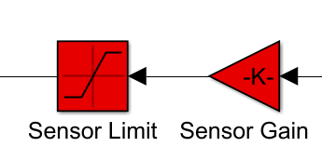
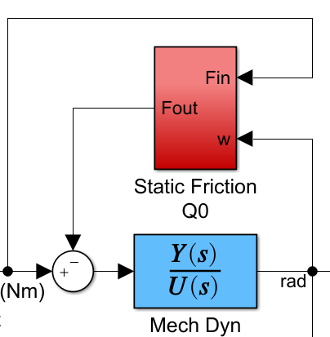

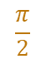

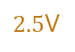

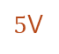

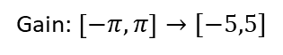

Sensor
Static Friction
Sensor Feedback
The sensor maps the actual angle of the motors to voltage linearly
Static friction works against the applied force and turns into dynamic friction after motor starts moving. It is given by:
$$F_{static}=μ_{sF}F_{N}$$
$$F_{static}=μ_{sF}g(mass_{\text{link}}+{mass}_{q1}+{mass}_{c.w.})$$
voltage
angle
Implementation
Gain: $\left[−π,π\right]→[−5,5]$
$5$V
$$π$$
If $τ_{\text{applied}}<τ_{\text{static}}$ then $τ_{\text{net}}=0$
$2.5$V
$$\frac{π}{2}$$
Motor 1 does not experience any noticeable static friction since $\text{mas}{\text{s}}_{\text{rotor}}≅0$

Slide 9
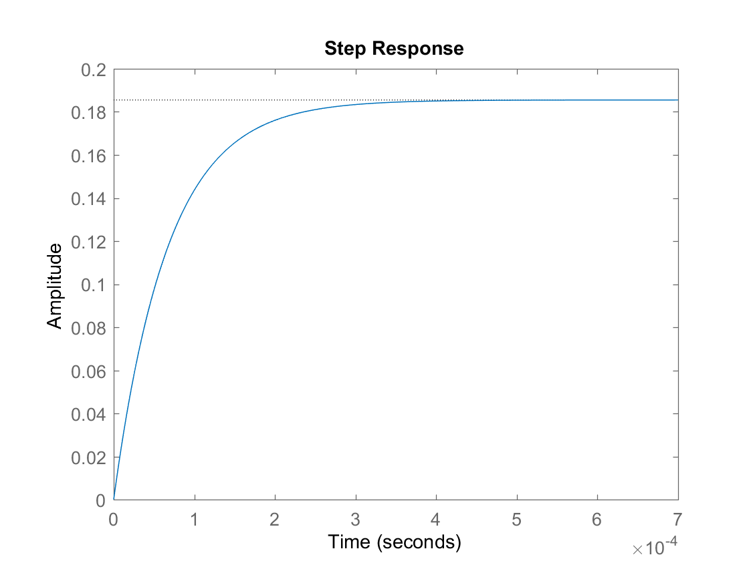
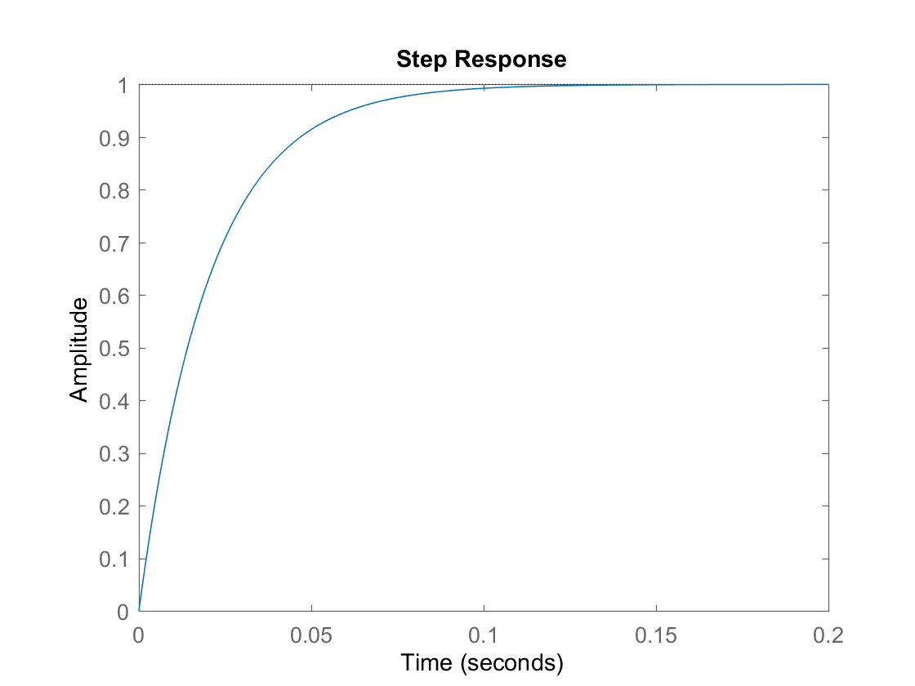
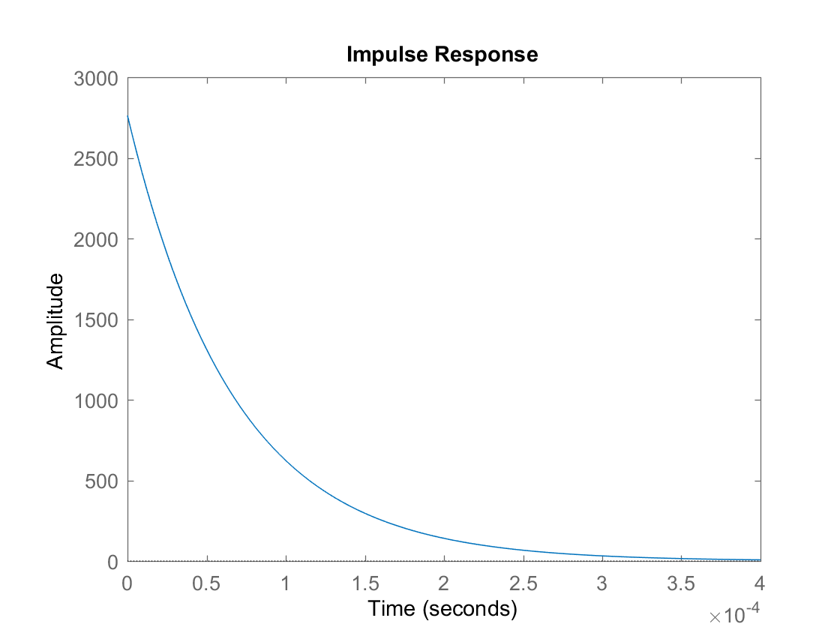
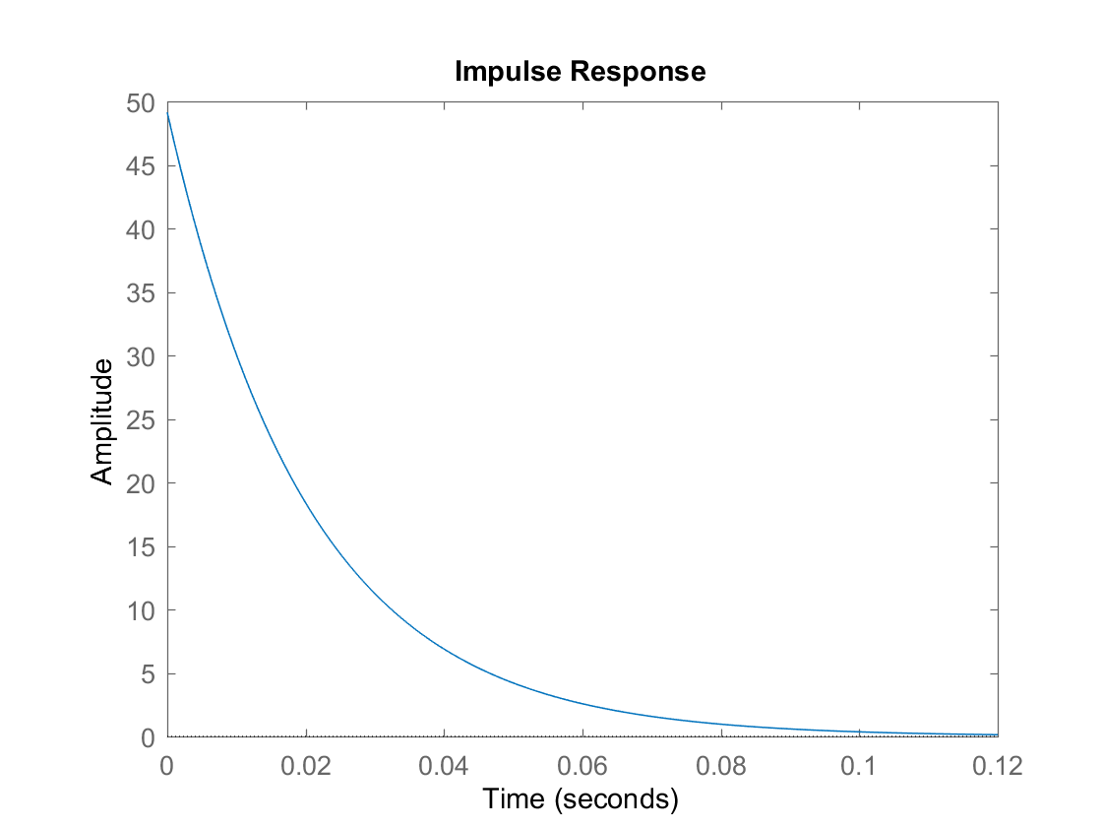


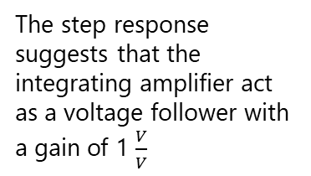

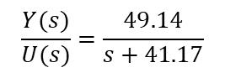
Electrical Response
Amplifier Response
$$\frac{Y(s)}{U(s)}=\frac{2762.4}{s+1.489×{10}^{4}}$$
$$\frac{Y(s)}{U(s)}=\frac{49.14}{s+41.17}$$
Performance
Rise time: $3×{10}^{−4}$s
Performance
Rise time: $0.1$s
The electrical system produces current given a voltage
The step response suggests that the integrating amplifier act as a voltage follower with a gain of 1 $\frac{V}{V}$
Internal inductances of the motors causes exponential behavior
Given a sudden jolt of voltage, the current spikes, but quickly dissipates

Slide 10
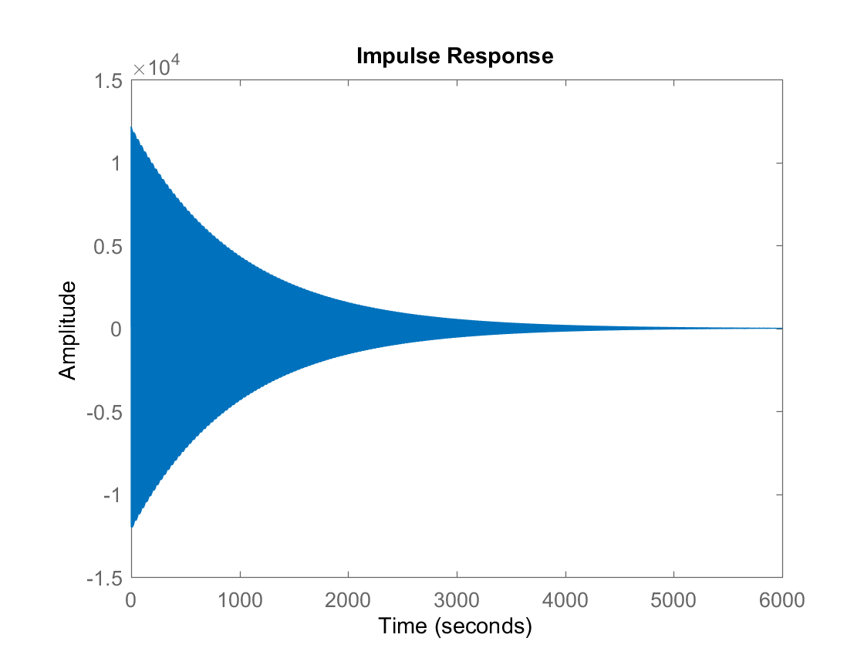
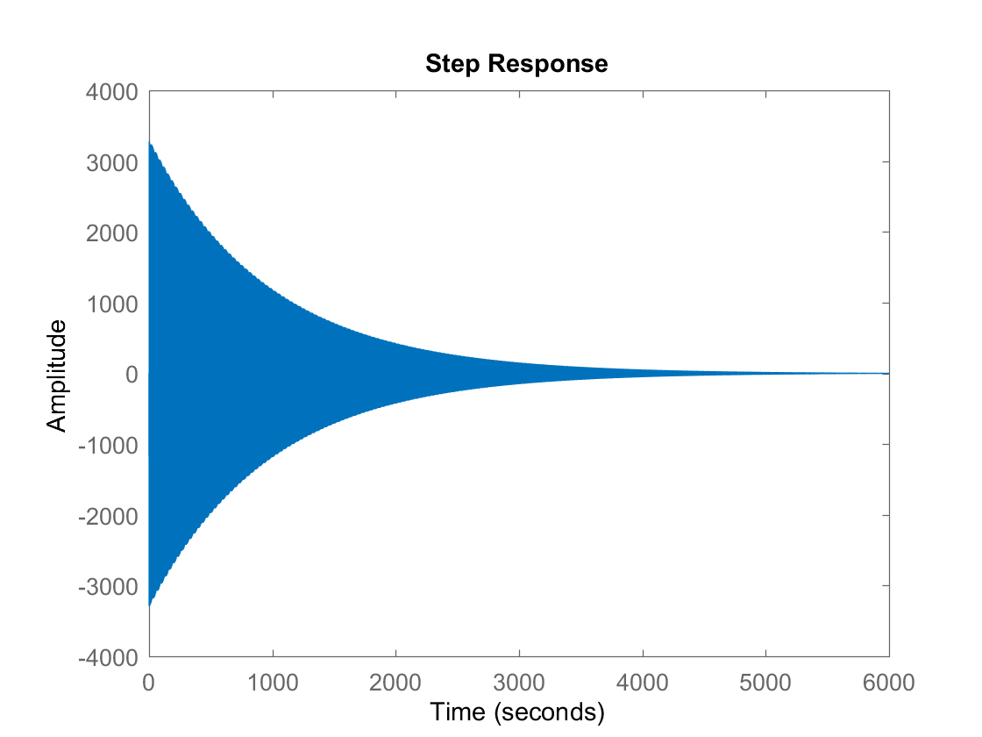
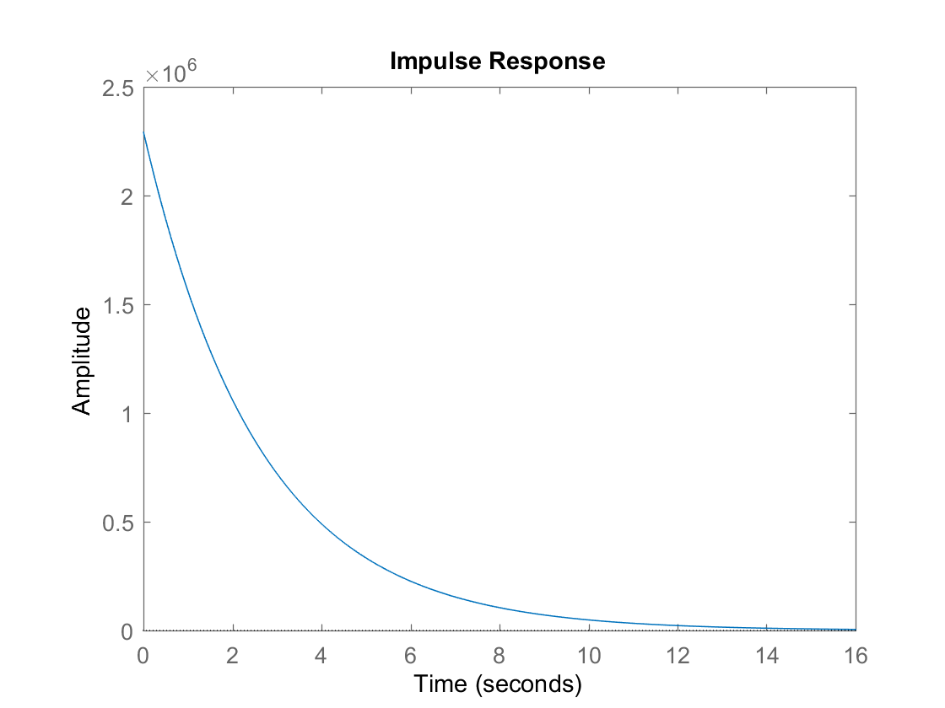
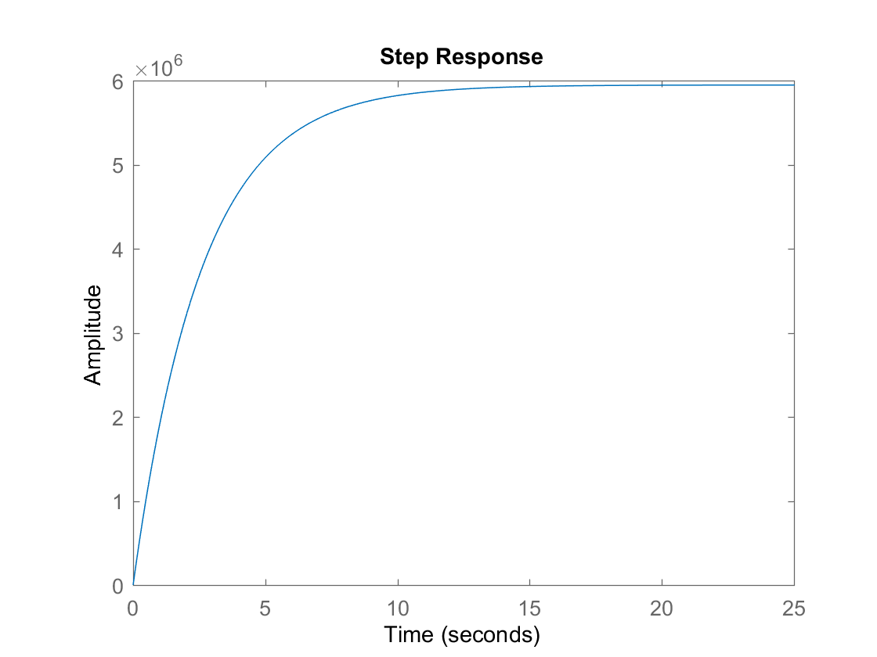

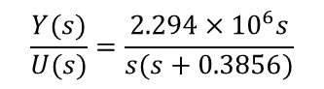
Motor 0 Response
$$\frac{Y(s)}{U(s)}=\frac{12644s}{s^{2}+0.00213s+14.11}$$
Motor 0 transfer function outputs angular velocity given some torque
Oscillation occurs due to the spring behavior
Angular velocity decays to 0 due to friction
Motor 1 Response
$$\frac{Y(s)}{U(s)}=\frac{2.294×{10}^{6}s}{s(s+0.3856)}$$
Given a impulse torque, the motor 1 angular velocity decays exponentially due to friction
With a constant torque, motor 1 speeds up to its maximum angular velocity

Slide 11
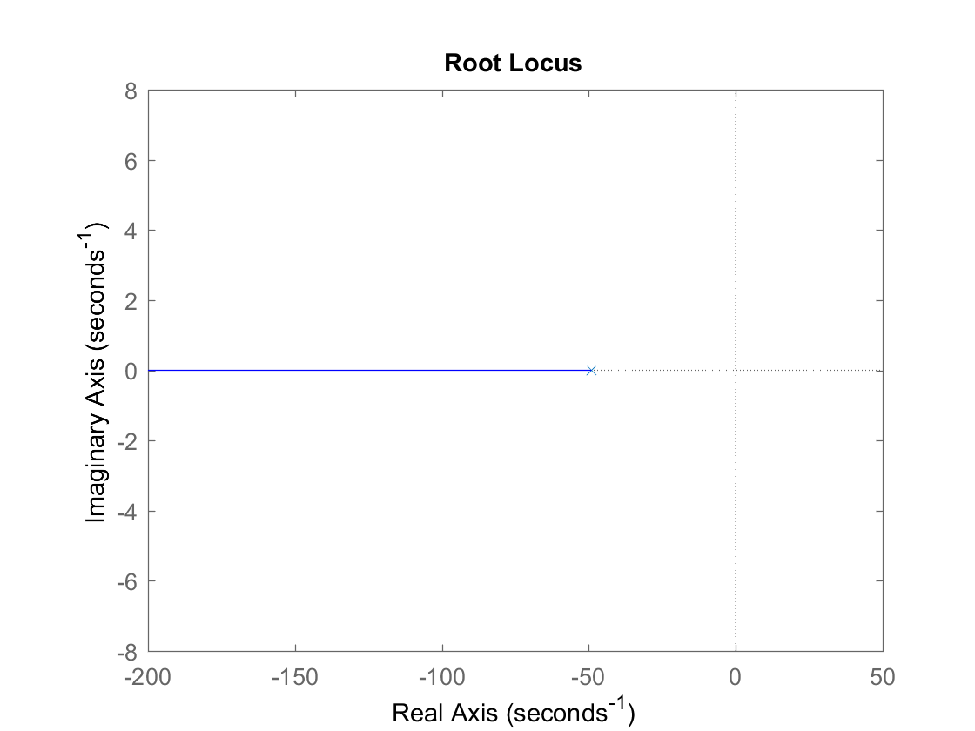
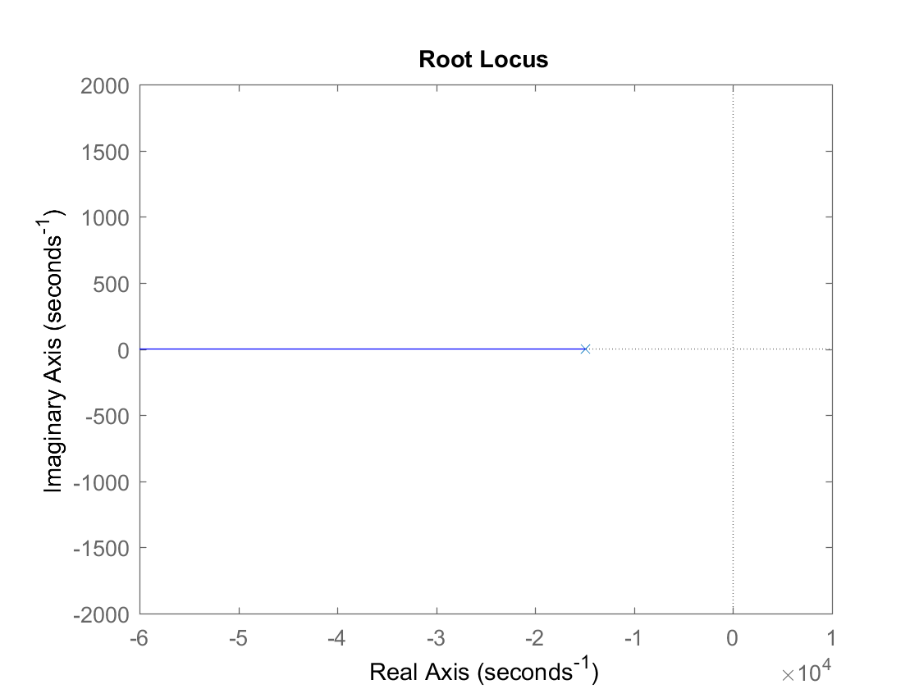


Root Locus
The electrical system, amplifier , and motor 1 are stable according to the root locus
Motor 0 has complex root locus, which explains the damped oscillation
Power amplifier
Electrical
Motor 0
Motor 1
To be continued in part 2 (PID Control)

Slide 12

Selective Laser Sintering 3D Printer
ELEC 341 Design Project
Part 2
Muchen He 44638154
Ou Liu 18800152
Notes:
0

Slide 13



System & Controller Overview
+
PID(s)
G(s)
Desired angle
-
Actual angle
H(s)
PID(s)=$K_{D}\frac{s^{2}×\frac{K_{P}}{K_{D}}s+\frac{K_{I}}{K_{D}}}{s}$
$K_{P}=$ Proportional Gain
$K_{D}=$ Differential gain
$K_{I}=$ Integral gain
The feedback gain converts the voltage from sensor back into angles; which has a net gain of 1
Linearized open loop response
Notes:
1

Slide 14

1. Obtain open-loop transfer function
2. Choose poles to eliminate
3. Root locus
4. Choose K=KD
5. Obtain KP, KI from KD
6. Fine tune PID based on system response
7. Check stability
Strategy
To successfully tune our PID to a minimum value, these are the steps we took
For the gain K, start with K that yields a critical damping
Step 1: find open loop transfer function of both motors
Step 2: choose poles to eliminate
Step 3: find root locus
Step 4: choose desired $K$value
Step 5: find starting $K_{p}, K_{i}, K_{d}$ base on the desired $K$ value
Step 6: adjust PID values based on system step response
Step 7: check the Nyquist stability criteria
Step 8: compare result with auto PID tune

Slide 15


Motor Selection
Keeping Q0 at default and changing Q1
We chose AMAX16 p75W SB motor as it outperforms all other motor and it’s lightweight – reducing load for the outer motor
Keeping Q1 as AMAX16 p75W SB motor and changing Q0:
The 6W motor has highest risetime, but performs much better in other criteria
Ultimately, we chose AMAX22 6W SB motor as it provided maximum power and torque – good for heavier loads
Notes:
2

Slide 16



System Review (q0)
Open Loop Transfer function (q0)
$$\frac{1.2815×{10}^{8}}{(s+1.523×{10}^{4})(s+49.17)(s^{2}+1.95s+96.77)}$$
Choose K=0.0648
for critical damping
Include starting PID values from zeroes
Consider poles close to the origin
cancel complex poles with zeros at (-1,-10j) and (-1,10j)
Notes:
3

Slide 17



System Review (q1)
Open Loop Transfer function (q1)
$$\frac{1.4146×{10}^{10}}{s(s+4.045×{10}^{4})(s+50.6)(s+49.17)}$$
Choose K=0.0028 for critical damping
Include starting PID values from zeroes
cancel poles closest to imaginary axis with zeros at 0, -49.17
Include starting PID values from zeroes
Notes:
4

Slide 18

PID Tuning
 | Rise Time | Overshoot | Settle Time | Steady State Error
$$K_{P}$$ | ↓ | ↑ | ↑ | ↓
$$K_{I}$$ | ↓ | ↑ | ↑ | Eliminate
$$K_{D}$$ | ↑ | ↓ | ↓ | No effect
The PID for Q0 is adequate from the starting values, but the risetime is too long, so we increased D-gain and I-gain. This caused more overshoot so we decreased P gain
PID values | Q0 |  |  | Q1
 | P-gain | I-gain | D-gain | P-gain | I-gain | D-gain
Starting | 0.1464 | 6.2707 | 0.0648 | 0.1377 | 0.00 | 0.0028
Intermediate | 0.123 | 8.470 | 0.0940 | 0.1360 | 0.03 | 0.0029
Final | 0.070 | 9.650 | 0.100 | 0.1366 | 0.00 | 0.0028
Notes:
5

Slide 19


Progression of PID Tuning
Risetime and settling time for Q0 improved drastically after fine tuning. Overshoot is decreased as well
Motor Q1 had a good starting point as it is easier to control. Fine tuning reduced overshoot
Step response of Q0 with PID
Step response of Q1 with PID
Notes:
6

Slide 20








Simulation Results
Starting
Simulation is ran with PID tuned at different stages: start, intermediate, and final. The maximum position error is reduced drastically
Max. position error: 45.2
Desired position
Intermediate
Max. position error: 6.98
Final
Max. position error: 3.29
Notes:
7

Slide 21

Nyquist Stability Criteria
The Nyquist stability criterion plot is used to determine how close our system with PID is to unstable
The system with finalized PID values is stable as seen in the Nyquist plot
Q0
Gain margin: 59.2 dB
Phase margin: 52 degrees
Q1
Gain margin: 15.4 dB
Phase margin: 4.1 degrees
Motor Q0 controller
Motor Q1 controller
Notes:
9

Slide 22






Result of PID Auto Tuner
Less control over steady state error
Step response of Q0 with PID tuner
Actual position
Greater instability
Tuning by hand is the better method
Q0 auto tune PID
Step response of Q1 with PID tuner
Position error
Q1 auto tune PID
Max. position error: 58.18
Notes:
8

